Slide 1
Operations Technology
Vision Projects
Sujith Muraleedaran

Slide 2

VISION PROJECTS (Plan & Status)
S.No | Project | Plant | Start Date | End Date | Current Status | Capex Cost | ROI
1 | Multiguaging - OCR Part No Identification | P.Palayam - Stellantis | 08.08.2025 | 18.11.2025 | Completed | 7,34,000 | 4.6 months
2 | Keyence Laser Measurement | P.Palayam - Stellantis | 15.08.2025 | 08.01.2026 | Completed | 12,23,000 | 1.15 years
3 | MPI Crack Identification- Knowledge Q | P.Palayam - Daimler | 03.01.2026 | 01.03.2026 | Completed | 8,25,560 | 7.5 Months

Slide 3
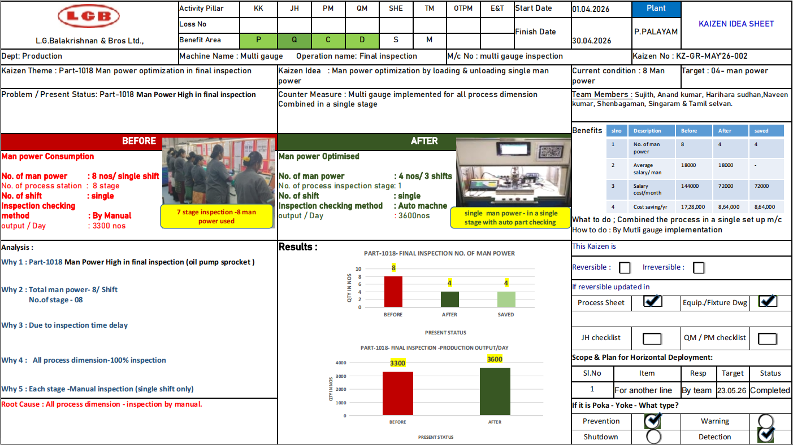
1
Home
Multiguaging Final Inpection
Plant : P-palayam| Project : SFQA

Slide 4
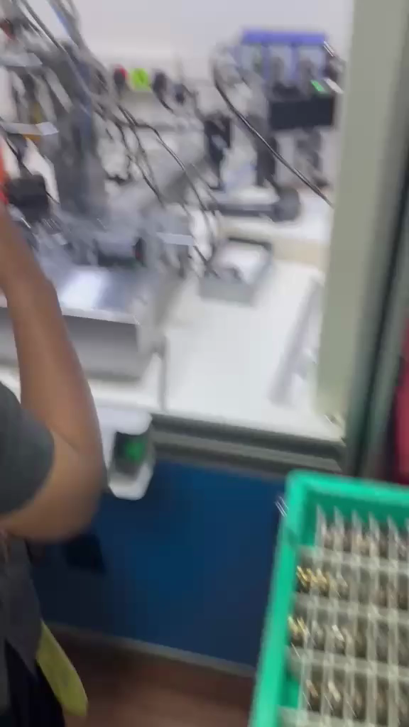
Multiguaging Final Inpection with OCR based component Tracking System - Results
ROI Calculations - OCR part Identification
Parameter | Unit Cost | Value
Total Machines Used |  | 1
Total Camera Used |  | 1
Operators Required per Shift (Current) |  | 8
Total Operators Required per Day (Current) | 8 × 1 | 8
Salary per Operator per Month |  | ₹ 22,000
Current Monthly Manpower Cost | 8 × 22,000 | ₹ 1,76,000
Current Annual Manpower Cost | 1,76,000 × 12 | ₹ 21,12,000
Operators Required After Automation |  | 1
Monthly Manpower Cost After Automation | 1 × 22,000 | ₹ 22,000
Annual Manpower Cost After Automation | 22,000 × 12 | ₹ 2,64,000
Annual Savings Due to Automation | 21,12,000 − 2,64,000 | ₹ 18,48,000
Total Automation Project Cost |  | ₹ 7,34,000
ROI Payback Period (Years) | 7,34,000÷ 18,48,000 | 0.39 years
ROI Payback Period (Months) | 0.39 × 12 | 4.68 Months
Operator Reduction | 08 − 01 | 07 Operators Reduced
Savings After 5 Years | (18,48,000 × 5) − 7,34,000 | ₹ 58,66,000
Plant : P-palayam| Project : SFQA

Slide 5
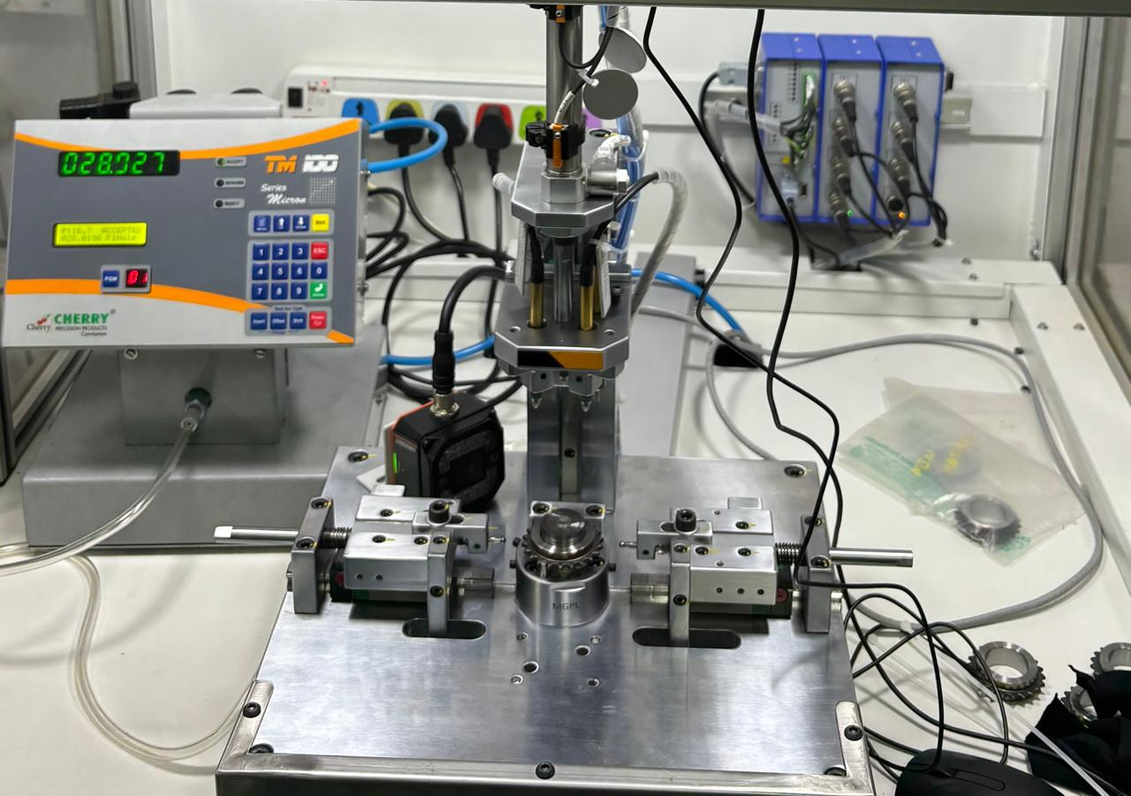
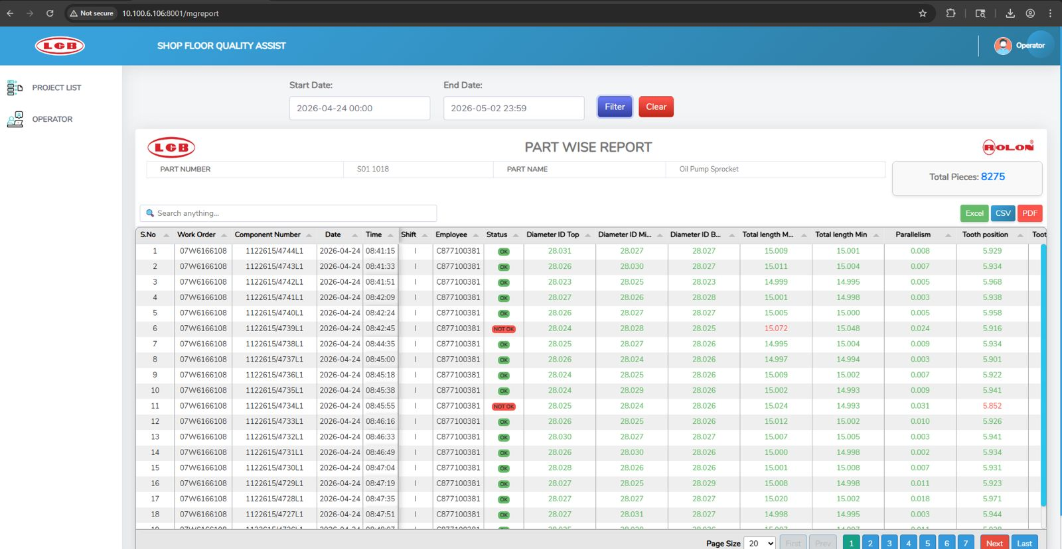
OCR-Based Component Tracking System
SC3000 OCR Camera — reads part number
MGPL Fixture — holds Oil Pump Sprocket
Display: 028.027 mm reading confirmed
OCR Measurement Station
Part-Wise Quality Report Dashboard
P-palayam

Slide 6
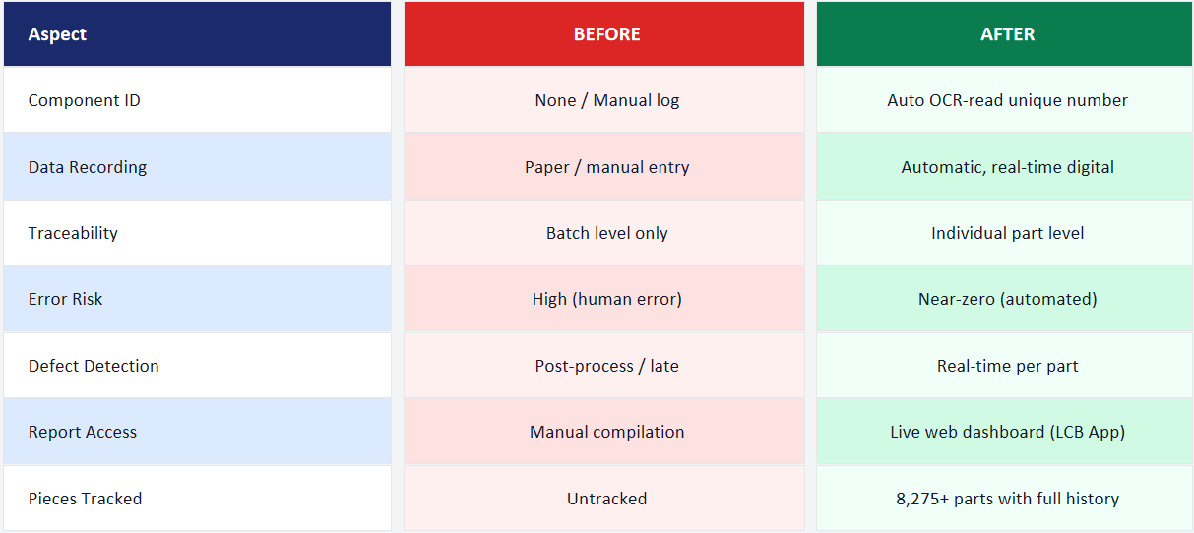
OCR-Based Component Tracking System - Before vs After
P-palayam

Slide 7
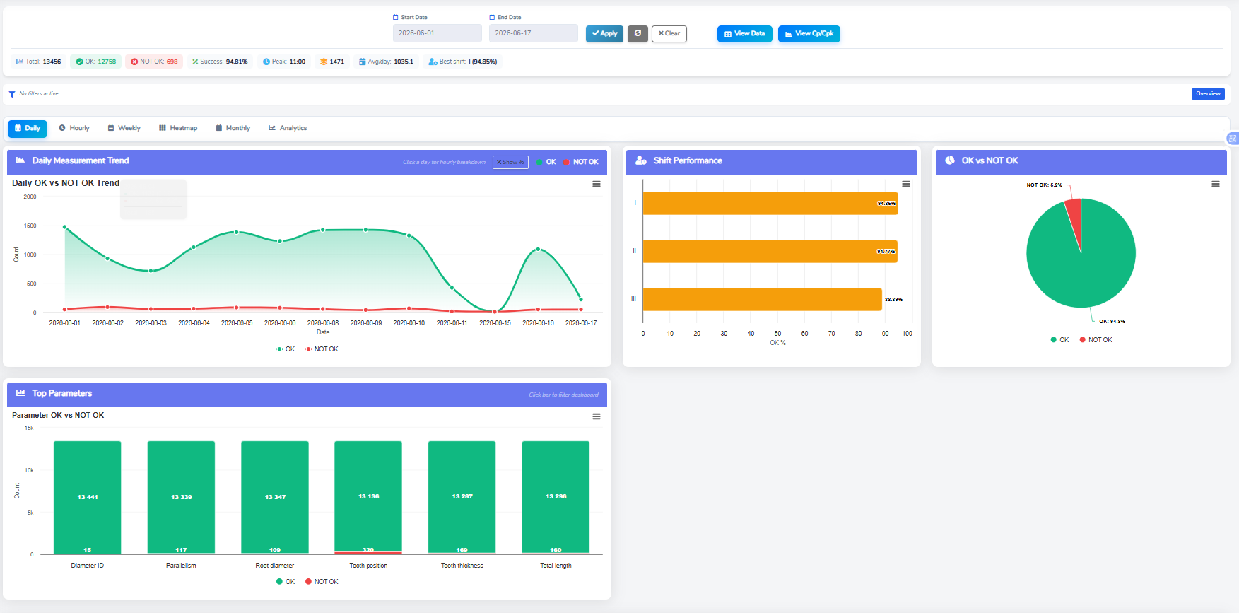
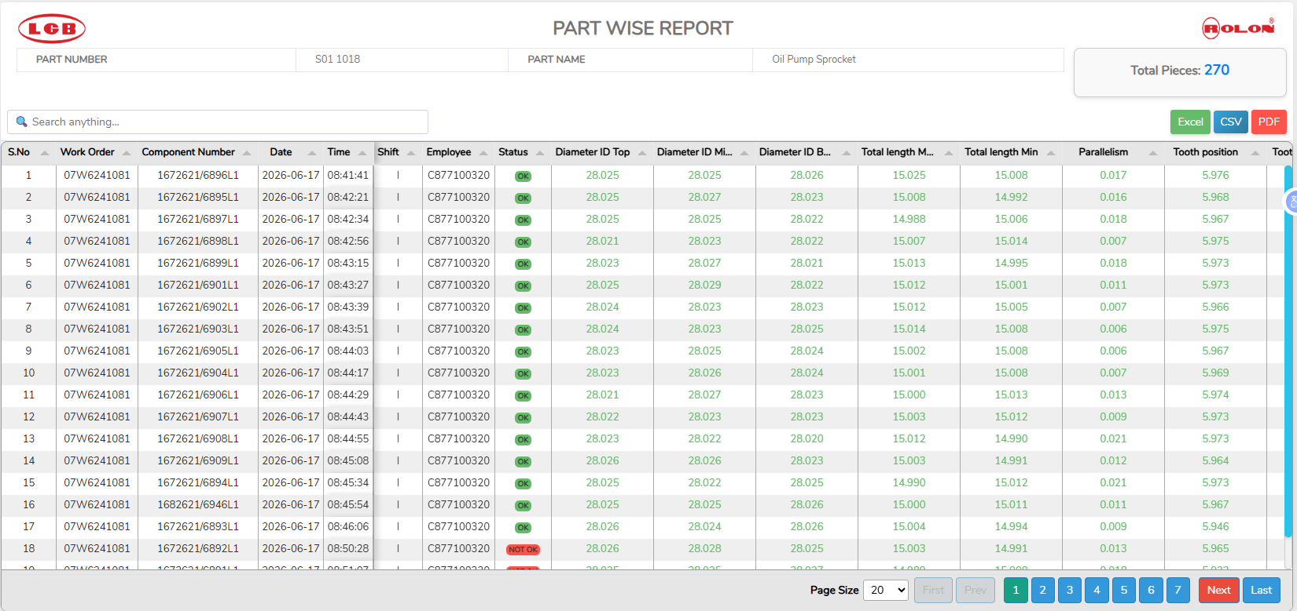
Multiguaging Final Inpection - Results
Plant : P-palayam| Project : SFQA

Slide 8
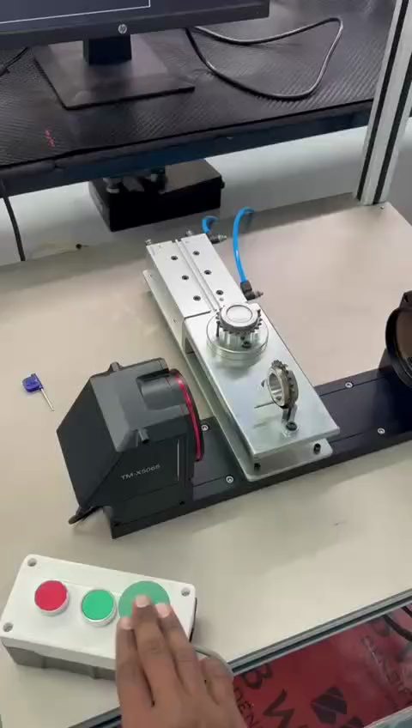
2
Home
Keyence Camera-Based Dimensional Measurement
Solution
Problem Statement
Contact Gauging Limitations
No Simultaneous Multi-Param
Manual Measurement Variation
Traditional contact gauges caused wear, required frequent calibration, and risked surface damage on precision Stellantis sprocket components.
Root Dia, OD, ID, Total Thickness and Teeth Distance had to be measured separately using different instruments — slow, error-prone, and operator-dependent.
Operator-to-operator variation in measurements led to inconsistent quality records and false accept/reject decisions.
P-palayam

Slide 9
ROI Calculations - Part Measurement project
Parameter | Calculation | Value
Total Gauges used |  | 5
Total Camera Used |  | 1
Operators Required per Shift (Current) |  | 5
Total Shifts per Day |  | 3
Total Operators Required per Day (Current) | 5 × 1 | 5
Salary per Operator per Month |  | ₹ 22,000
Current Monthly Manpower Cost | 5 × 22,000 | ₹ 1,10,000
Current Annual Manpower Cost | 1,10,000 × 12 | ₹ 13,20,000
Operators Required After OCR |  | 1
Monthly Manpower Cost After Automation | 1 × 22,000 | ₹ 22,000
Annual Manpower Cost After Automation | 22,000 × 12 | ₹ 2,64,000
Annual Savings Due to Automation | 13,20,000 − 2,64,000 | ₹ 10,56,000
Total Automation Project Cost |  | ₹ 12,23,000
ROI Payback Period (Years) | 12,23,000 ÷ 10,56,000 | 1.15 Years
ROI Payback Period (Months) | 1.15 × 12 | 13.8 Months
Operator Reduction | 5 − 1 | 04 Operators Reduced
Savings After 5 Years | ( 10,56,000 × 5) − 12,23,000 | ₹ 40,57,000
Plant : P-palayam| Project : SFQA

Slide 10
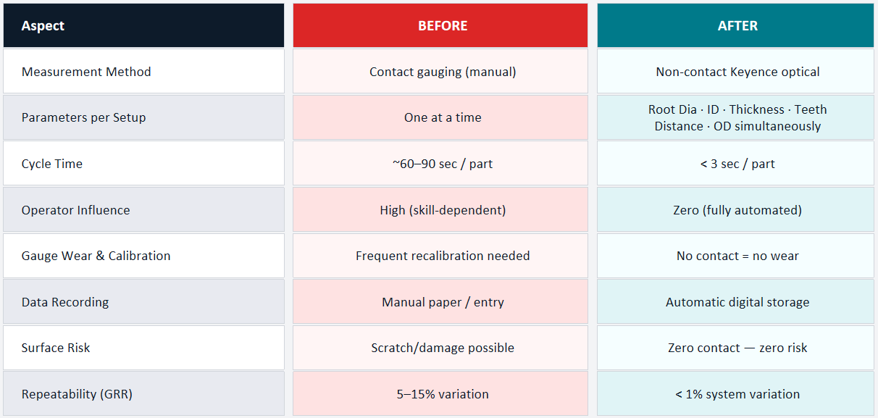
Keyence Camera-Based Dimensional Measurement - Before vs After
P-palayam

Slide 11
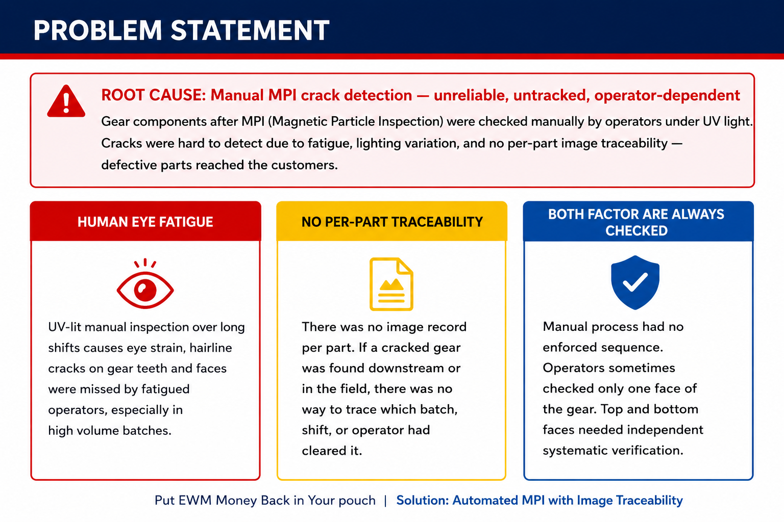
3
Home
MPI Crack Detection Automation
P-palayam

Slide 12
MPI Crack Detection Automation - ROI calculation
Parameter | Calculation | Value
Total System used |  | 1
Total Camera Used |  | 1
Operators Required per Shift (Current) |  | 2
Total Shifts per Day |  | 3
Total Operators Required per Day (Current) | 2 × 3 | 6
Salary per Operator per Month |  | ₹ 22,000
Current Monthly Manpower Cost | 6 × 22,000 | ₹ 1,32,000
Current Annual Manpower Cost | 1,32,000 × 12 | ₹ 15,84,000
Operators Required After OCR |  | 1
Monthly Manpower Cost After Automation | 1 × 22,000 | ₹ 22,000
Annual Manpower Cost After Automation | 22,000 × 12 | ₹ 2,64,000
Annual Savings Due to Automation | 15,84,000 − 2,64,000 | ₹ 13,20,000
Total Automation Project Cost |  | ₹ 8,25,560
ROI Payback Period (Years) | 8,25,560 ÷ 13,20,000 | 0.625 Years
ROI Payback Period (Months) | 0.625 × 12 | 7.5 Months
Operator Reduction | 6 − 3 | 03 Operators Reduced
Savings After 5 Years | ( 13,20,000 × 5) − 8,25,560 | ₹ 57,74,440
P-palayam

Slide 13
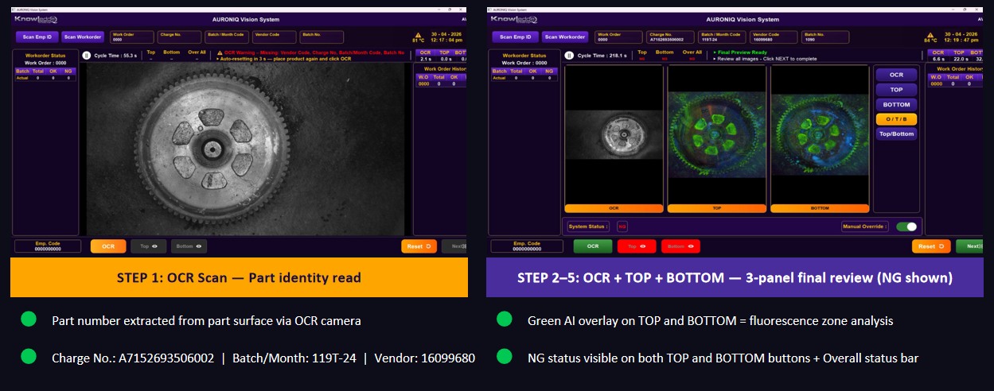
MPI Crack Detection Automation - LIVE AURONIQ SCREENS
P-palayam

Slide 14
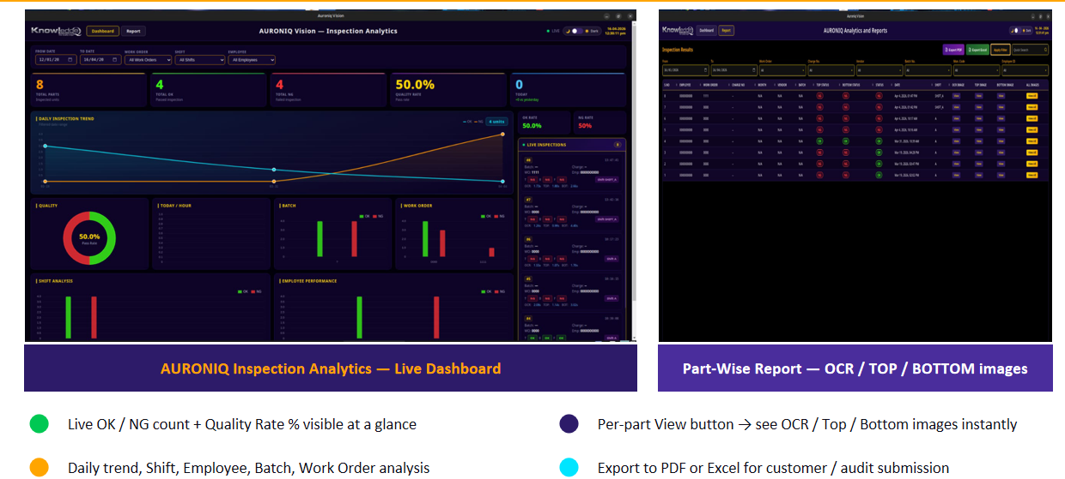
MPI Crack Detection Automation - ANALYTICS DASHBOARD & INSPECTION REPORT
P-palayam

Slide 15
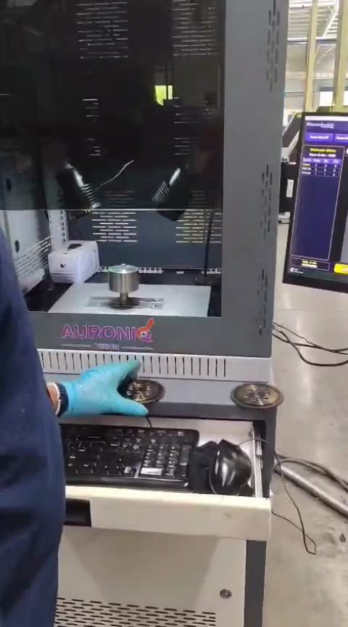
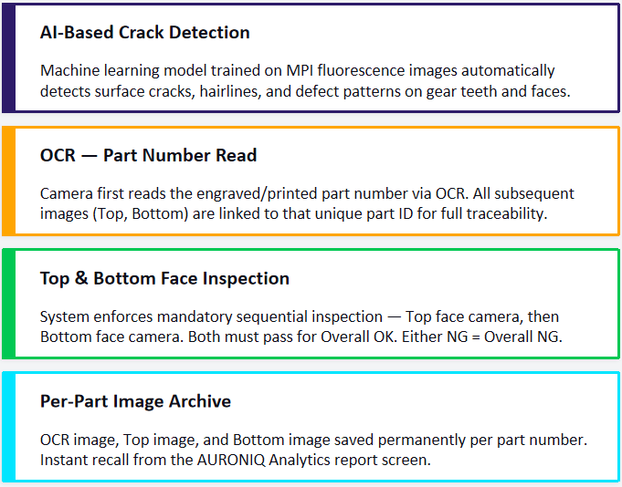
MPI Crack Detection Automation - Solution & Results
P-palayam

Slide 16
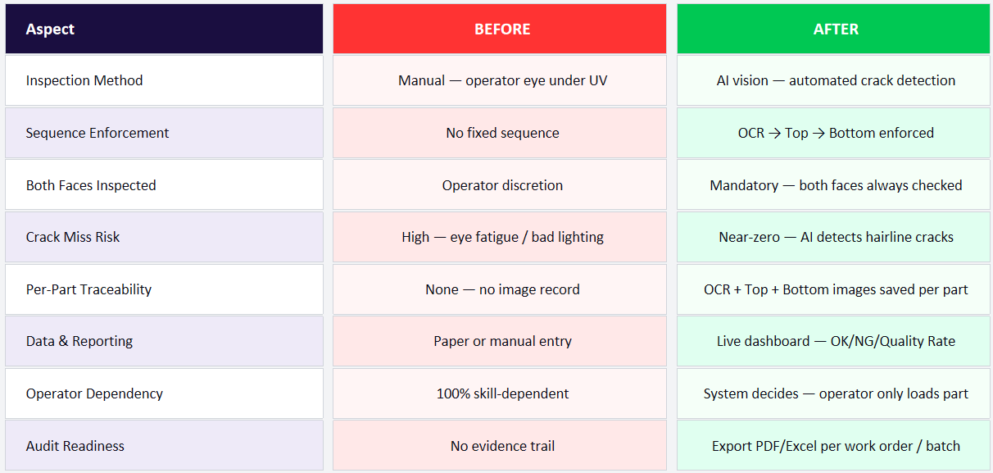
MPI Crack Detection Automation - LIVE AURONIQ SCREENS
Plant : P-palayam| Project : SFQA

Slide 17
Thank you

